Slide 1
DBMS
Lecture-3

Slide 2
Objectives of Three-Level Architecture
All users should be able to access same data but have a different customized view.
A user’s view is immune to changes made in other views
Users should not need to know physical database storage details.
DBA should be able to change database storage structures without affecting the user’s view.
Internal structure of database should be un affected by changes to physical aspects of storage.

Slide 3
Objectives of Three-Level Architecture
DBA should be able to change conceptual structure of database without affecting all users

Slide 4
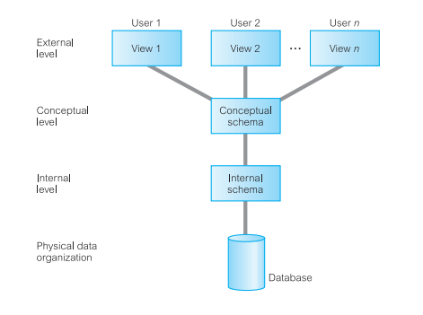
ANSI-SPARC Three-Level Architecture

Slide 5
External Level
Users’ view of the database
Describes that part of database that is relevant to a particular user
Different views may have different representation of same data (e.g. different date formats, age derived from DOB etc.)

Slide 6
Conceptual Level
Community view of the database
Describes what data is stored in the database and the relationships among the data.
Along with any constraints on data
Independent of any storage considerations

Slide 7
Internal Level
The physical representation of the database on the computer
describes how the data is stored in the database
physical implementation of the database to achieve optimal runtime performance and storage space utilization
Data structures and file organizations used to store data on storage devices.
Interfaces with the operating system access methods (file management techniques for storing and retrieving data records) to place the data on the storage devices, build the indexes, retrieve the data, and so on.

Slide 8
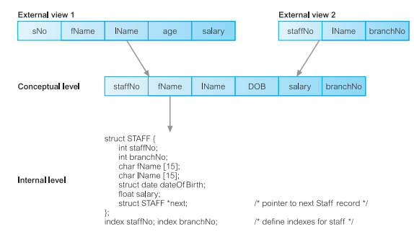
Differences between Three-Levels

Slide 9
Schemas
External Schemas
also called subschemas
Multiple schemas per database
correspond to different views of the data
Conceptual Schema
describes all the entities, attributes, and relationships together with integrity constraints
Only one schema per database

Slide 10
Schemas
Internal Schema
a complete description of the internal model, containing the definitions of stored records, the methods of representation, the data fields, and the indexes and storage structures used
Only one schema per database

Slide 11
Mappings
The DBMS is responsible for mapping between these three types of schema:
the DBMS must confirm that each external schema is derivable from the conceptual schema, and it must use the information in the conceptual schema to map between each external schema and the internal schema
Types of mappings
conceptual/internal mapping
External/conceptual mapping

Slide 12
Conceptual/Internal mapping
Enables DBMS to:
to find the actual record or combination of records in physical storage that constitute a logical record in the conceptual schema
Together with any constraints to be enforced on the operations for that logical record.
It also allows any differences in entity names, attribute names, attribute order,data types, and so on to be resolved

Slide 13
External/Conceptual mapping
map names in the user’s view to the relevant part of the conceptual schema.

Slide 14
Instances
Database Schema
Description of the database
Specified during design phase
Remain almost static
Database Instance
Data in the database at any particular point in time
Dynamic
Also called an intension (or state) of database

Slide 15
Data Independence
Logical Data Independence
Refers to immunity of the external schemas to changes in the conceptual schema.
conceptual schema to changes (e.g addition/removal of entities)
Should not require changes to external schema or rewrites of application programs

Slide 16
Data Independence
Physical Data Independence
Refers to immunity of the conceptual schema to changes in the internal schema.
Internal schema changes (e.g different file organizations, storage structures, storage devices etc.)
Should not require change to conceptual or external schemas

Slide 17
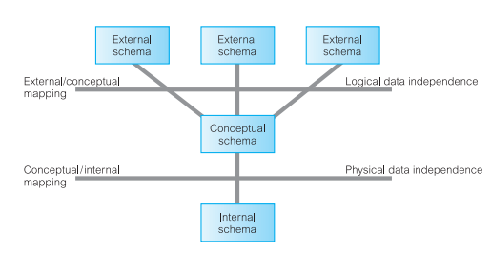
Data Independence & Three-Level Architecture

